Slide 1
OIL PRICE PREDICTION
GROUP 2
Dipak Anil Wagh
Ashwini Shirishkumar Chobhe
Pooja Pandharinath Lokhande
Vibha Utpal Patel
Adwaith MP
MENTOR: KARTHIK

Slide 2
Business Problem
To produce crude oil and refined industrial products at the lowest possible cost to remain competitive.
A long-term risk for oil and gas companies is a dwindling natural supply.
Short-term risks include political stances and supply-and-demand.
Objective
Crude oil fluctuation have impact on global economies and thus prices forecasting can assist in minimising the risk associated with volatility in oil prices.price forecasting are very important to various stakeholders: government,public,private enterprises,policy makers & investors
To maintain higher standards in respect of safety,environment projection & occupational health at all production unit

Slide 3
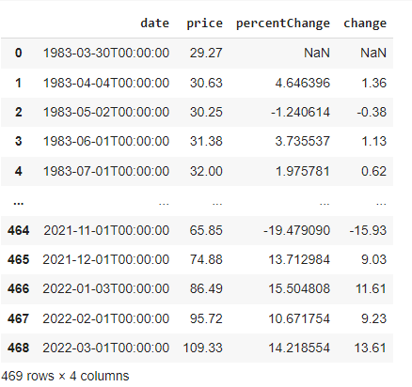
Data Extraction : https://www.kaggle.com/datasets/sc231997/crude-oil-price
We extract dataset from kaggle.com.Crude oil price in USD/Bbl from 1983 to present.The Crude Oil WTI (USD/Bbl) dataset was created with the expectation to understand the impact of global oil prices on any country's economy
Dataset
Dataset contains total 469 rows & 4 columns
Dataset contains 4 columns date,price,percent change
& change
In dataset oil prices are from year 1983-2022 in USD/Bbi
Date

Slide 4
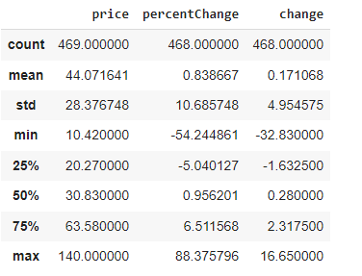
EDA
converted timeline date
No missing values & no duplicated data in dataset.
Max price 140 USD/bbl and min price 10.42 USD/bbl
Description of data
max oil price -140
Min oil price -10.42
Total count-469

Slide 5
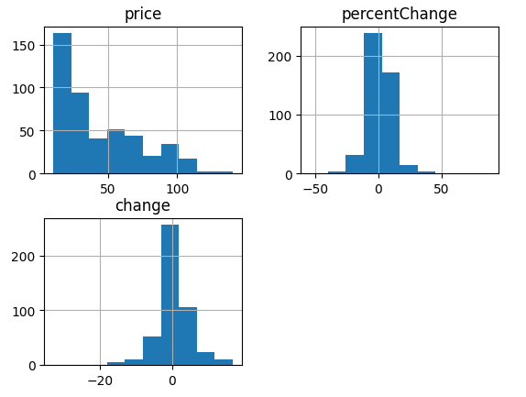
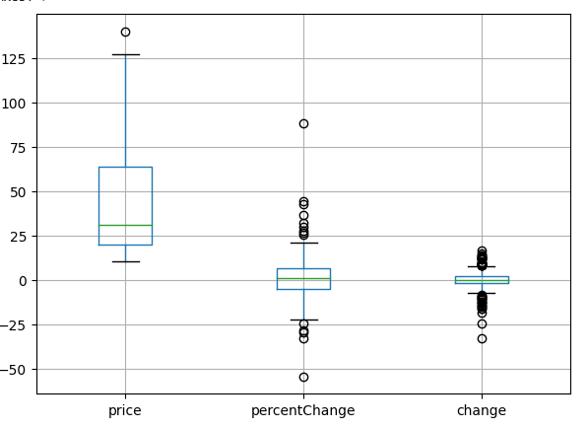
Data visualization
We can predict from Box plot outlier exist at 140
Data of price have positive skewness

Slide 6
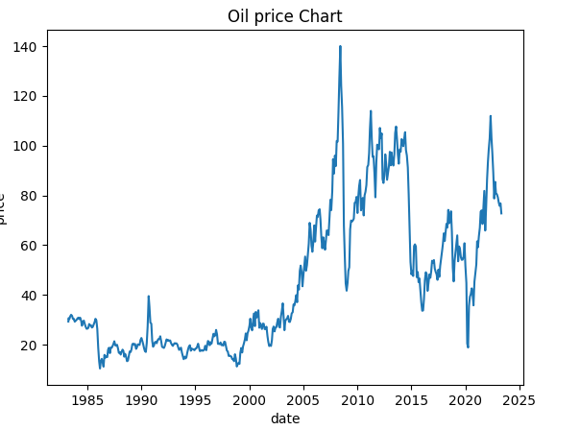
Visualization on oil prices
line plot of oil prices Vs date predict
that dataset contains an obvious trend
but no obvious seasonality.
Oil prices are after 1982 falls because of
Reduced demand . prices growing up to
2008 & hit max price.The 2008 financial
crisis and Great Recession induced a market
which drop oil
Prices drastically.The COVID-19 pandemic
triggered an unprecedented demand shock
in the oil industry, leadis to collapse oil prices.

Slide 7
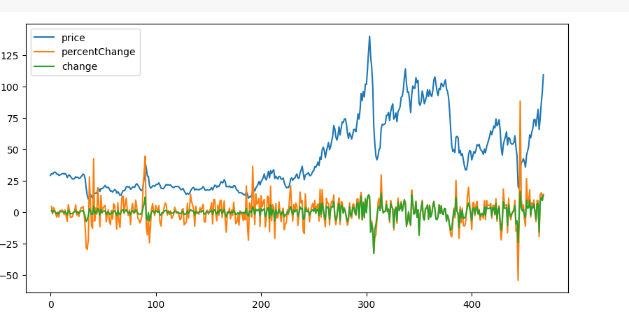
Visualization - oil prices , PercentChange & change over Time

Slide 8
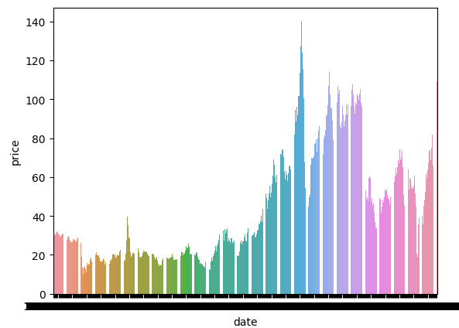
Visualization of Oil prices with time in form of Barplot

Slide 9
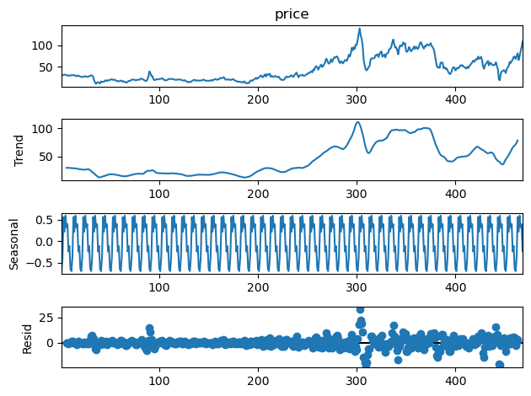
Seasonality plot using Additive Model
Using seasonal decompose function, timeseries data is divided into trend, seasonal, and residual.
Additive Model
Trend: Initially constant, then increasing rapidly, then decreasing
Seasonal: Seasonality is present as we can clearly observe periodic pattern.
Residual: It has higher variance at some point.

Slide 10
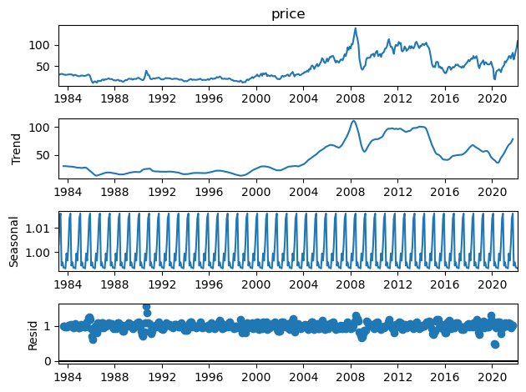
Seasonality plot using Multiplicative Model
Using seasonal decompose function, timeseries data is divided into trend, seasonal, and residual.
Multiplicative Model
Trend: Initially constant, then increasing rapidly, then decreasing
Seasonal: Seasonality is present as we can clearly observe periodic pattern.
Residual: It has lower variance at some point.

Slide 11
Stationarity Check
Augmented Dickey Fuller (ADF Test)
Result: 0.3890874351157114, that is greater than 0.05, we accept the null hypothesis that is the data is non-stationary.
The time series data is non-stationary.

Slide 12
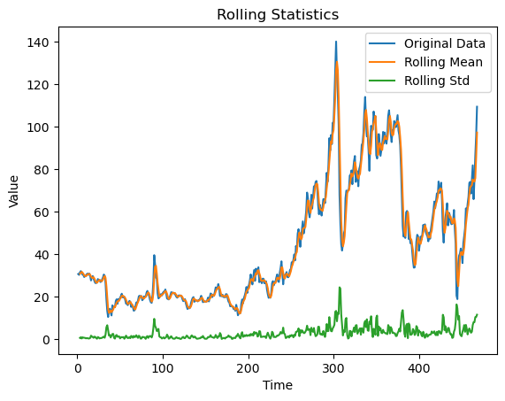
Stationarity Check
. Rolling statistics
From graph, we can observe that the time series data is non-stationary. Mean is not constant over period of time but standard deviation is constant.

Slide 13
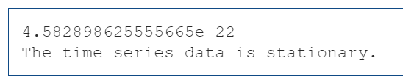
Removing Non Stationarity
Before modelling, we need to remove seasonality/Non stationarity
ts_log = np.log(df2['price'])
ts_log_diff = ts_log - ts_log.shift()
ts_log_diff.dropna(inplace=True)
First, log transformation is applied and taking difference with shifted version of itself.
After that, ADF test is applied to check stationarity.

Slide 14
Model Building
ARIMA(Auto-Regressive Integrated Moving Average) Model
Deciding Parameters:
Number of AR(Auto-Regressive) terms (p)
Number of MA (Moving Average) terms (q)
Number of Differences (d)
To determine, p and q, we can use Autocorrelation Function (ACF) and Partial Autocorrelation Function (PACF) plots.

Slide 15
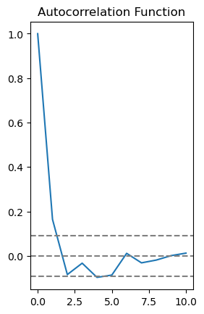
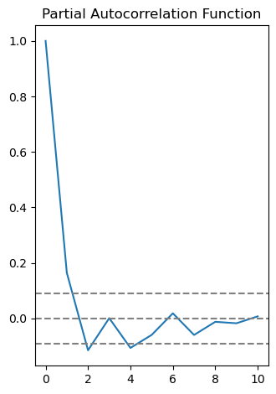
ACF & PACF
Optimum p-value:2 and q-value: 2

Slide 16
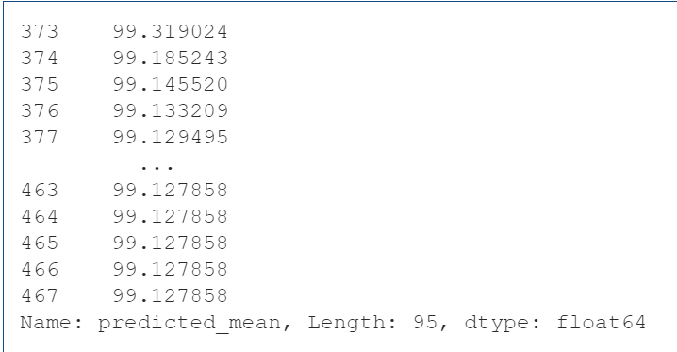
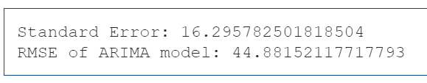
ARIMA Model
80% of Training data and 20%of Testing data
Optimum parameters
p=2,d=1,q=2
Predictions for test data

Slide 17

Let’s Explore other models
Linear Model
Linear regression using Ordinary Least Squares (OLS) method
regression of price variable over t
Some variables used in code:
t - a one-dimensional array containing integers from 1 (inclusive) to 469 (exclusive)
t_squared - A one dimensional array containing squared value of t.
log_prices- A one dimensional array containing logarithmic values of price

Slide 18
Other various Linear regression Models
Exponential- linear regression of log_price over t
Quadratic- linear regression of price over t and t_squared
Additive seasonality- linear regression of prices over months
Additive quadratic seasonality- linear regression of price over t,tsquared and months
Multiplicative Seasonality - linear regression of log_price over months
Multiplicative Additive Seasonality - linear regression of log_price over t and months

Slide 19
Long Short-Term Memory (LSTM) Model
A type of Recurrent Neural Network (RNN), where features are applied as an input.
More parameters to be learned
Platforms and Libraries Used: TensorFlow
Keras.models - -> sequential
Keras.layers
LSTM,Dense

Slide 20
LSTM model: Specifications
Sequential model that is Linear stack of layers
Model contains total three layers
Two layers: LSTM One Layer: Dense
LSTM layers with 50 units each.
Batch size (Number of samples per gradient update): 32
Optimizer: ADAM
Epochs: 50

Slide 21
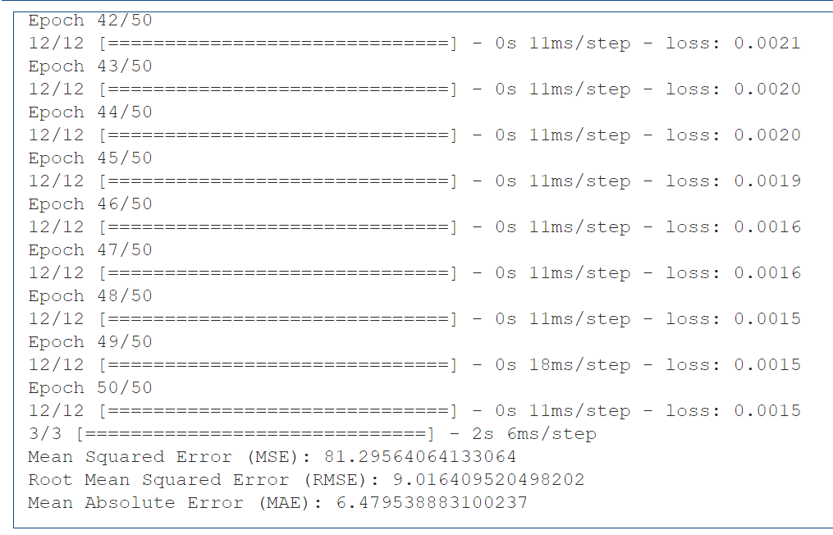
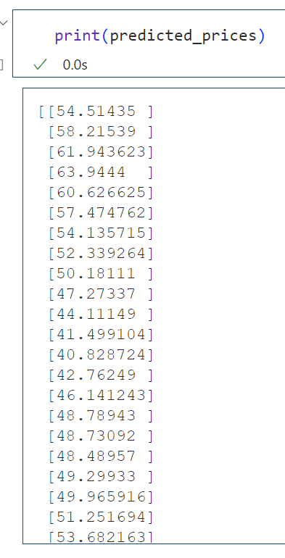
Evaluation of LSTM on Test Data

Slide 22
Holter-Winters Seasonal Model
Also known as triple exponential seasoning model
Three components of model are Level, Trend, and Seasonality.
Considered two seasonality
Additive: Seasonal component is added to the level and trend, forecasted values are addition of all three components
Multiplicative: Seasonal component is multiplied by the level and trend, forecasted values are multiplication of all three components

Slide 23
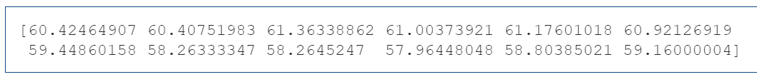

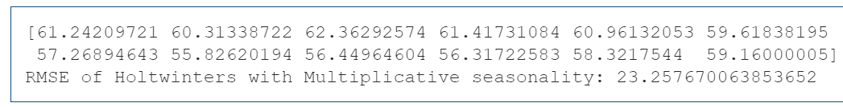
Evaluation of Holter-Winters Seasonal Model
Predicted Values for Additive Seasonality Model
Predicted Values for Multiplicative Seasonality Model

Slide 24
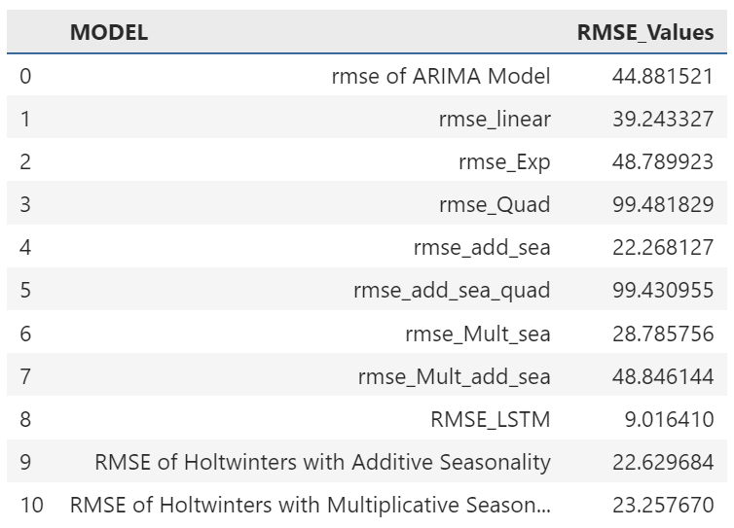
Comparative Analysis of all Models
Observations:
The lowest RMSE is of LSTM network that is 9.1845

Slide 25
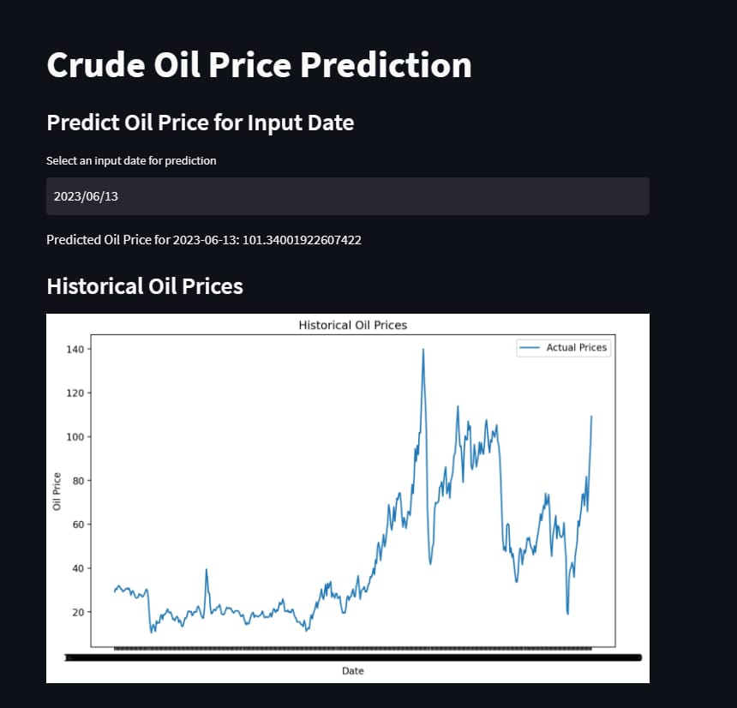
Deployment
We deployed our
model via streamlit

Slide 26
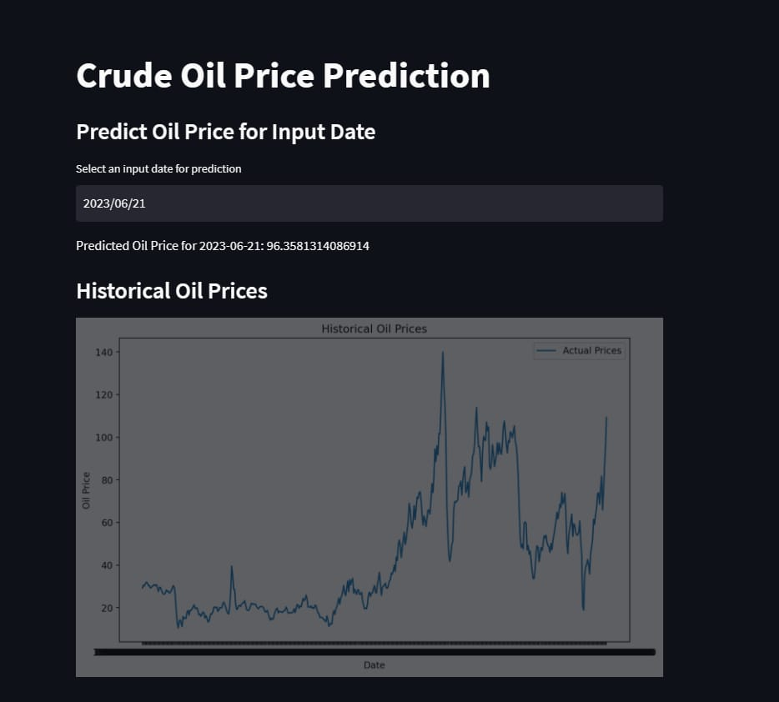
samples
.

Slide 27
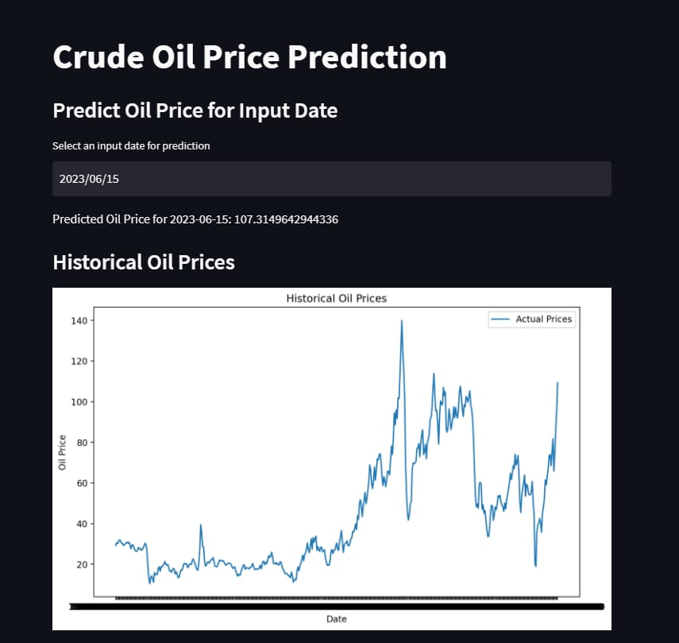
.
.

Slide 28
Challenges we faced
Finding the right dataset
Understanding the tables and their purpose
Cleaning of data
Making data stationary, standardizes,hyper tuning parameters for model building
Model building
Selecting the correct model giving accurate oil prediction and low RMSE value
Model deployment

Slide 29
Conclusion
LSTM is good for time series because it is effective in dealing with time series data with complex structures, such as seasonality, trends, and irregularities, which are commonly found in many real-world applications.

Slide 30
THANK YOU

